Slide 1
SITE Release 3.0 10/1/2013 – 12/31/2013
Sept 26th, 2013

Slide 2
Agenda
SITE Goals
SITE Release 3.0
Top Level Activities
Resources
Development Environment
New Sandboxes
PD
QM
Enhancements
SITE SDO Interactions
SITE Team and ESAC Team Responsibilities
Timeline and Deliverables
Risks
Next Steps

Slide 3
SITE Goals
Enable rapid adoption of standards that support interoperability and certification
Reduce ambiguity in standards
Improve dialogue among implementers and SDOs
Improve implementability of standards
Answer implementation questions clearly
Guide issues to appropriate SDO process
Provide test implementation on pre-ballot standards for vendors to test implementability

Slide 4
SITE Release 3.0 – Top Level Activities
Enhancements to existing SITE Platform features
Direct Sandbox
C-CDA Sandbox
Security Improvements
SITE Usability
SITE 508 Compliance
Metrics and Reporting
SDO Interactions
Moderator Activities
New Features
SITE development environment
Provider Directories
Quality Measures
Start C-CDA R2 Incorporation

Slide 5
SITE Release 3.0 – Resource Plan
Activity | Primary Person | SME
Direct Sandbox | Chris Cimaszewski | Nagesh Bashyam (Dragon)
Metrics and Reporting | Chris Cimaszewski | Nagesh Bashyam
Security Improvements | Chris Cimaszewski | Nagesh Bashyam
SITE Usability Improvements | Jason Goldwater | Jason Goldwater, Bill Dyer
SITE 508 Compliance/Testing | Manaar / Ai Engineer | Chris Cimaszewski
C-CDA Sandbox improvements | Dan Brown | Brett Marquard
Provider Directories | Alan Viars | Nagesh Bashyam
Quality Measures | Eric Tang | Brett Marquard
C-CDA R2 | Dan Brown, Nagesh Bashyam | Brett Marquard
SITE Development Environment | Chris Cimaszewski | Chris Cimaszewski
SDO Interactions | Bill Dyer (HL7), Nagesh Bashyam (IHE) | Brett Marquard (HL7)
SITE Moderator Activities | Bill Dyer | Bill Dyer/(Standards SMEs)
Project Management | Bill Dyer | Bill Dyer

Slide 6


SITE - QA/Test/Dev Environment Overview
3 EC2 Linux Medium Instances with the configuration shown below
Dev-2
Direct Sandbox
Apache James + Java RI
C-CDA R1 and R2 Validators (MDHT)
QRDA Validator (Cypress and Schematron)
Ruby on Rails for Cypress
Tomcat 7, Java 7
MDHT Build Server using Java 5
Dev-1
Apache HTTP Proxy Server
Liferay Portal
Tomcat 6, Java 6
SITE Portlets (Java Spring MVC+Bootstrap+jQuery)
Dev-3
SOAP Sandbox
PD Sandbox
Apache Directory Server
SOAP UI
PD Build Server (Jenkins)
Tomcat 7, Java 7
SITE Dev Team
SITE Development Repository: GitHub
SITE Build Tool: Maven
SITE Dev Team IDE: Eclipse

Slide 7
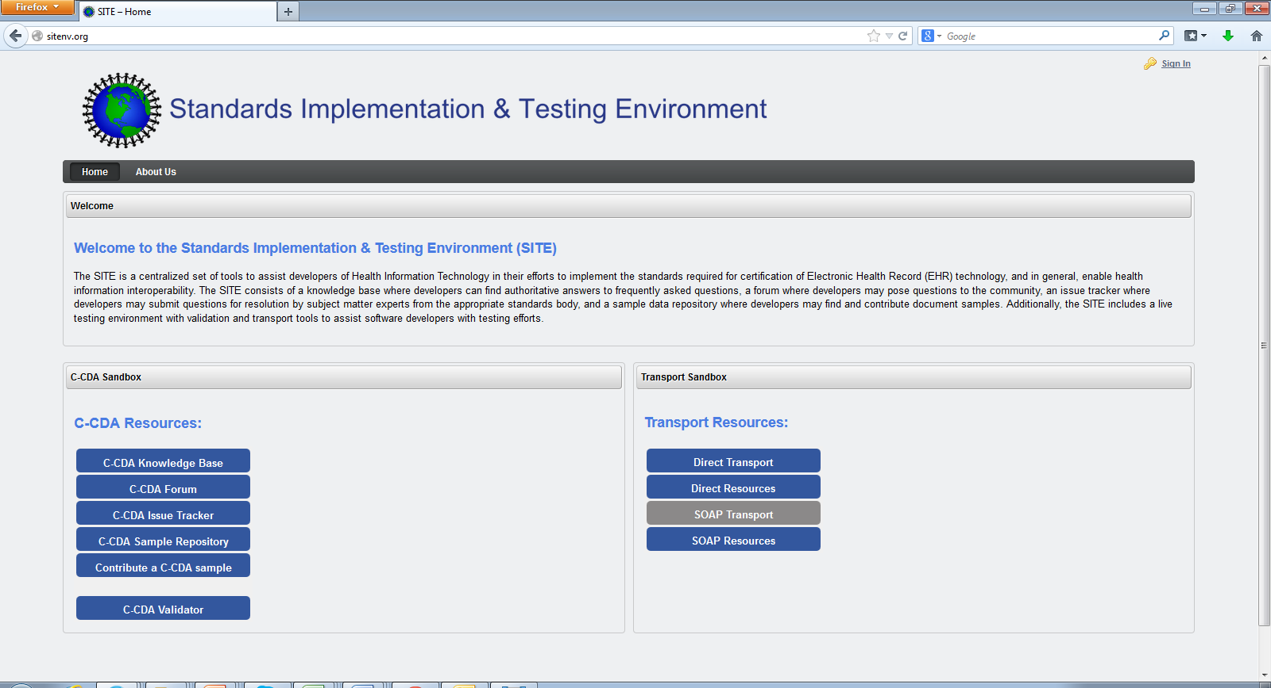
SITE – New Sandboxes
Quality Measures Sandbox
Provider Directory Sandbox
QRDA Knowledge Base
PD Knowledge Base
QRDA Forums
PD Forums
QRDA Issue Tracker
PD Test Tool
QRDA Repository
QRDA Validators

Slide 8
SITE - Provider Directory

Slide 9
SITE - Provider Directory Scope
Integrate the PDTI tool into SITE to support developers and implementers testing the following versions of PD standards
ModSpec v1.0
IHE HPD with CP 601 (Not supported currently)
EHR-IWG HPD+ 1.1
Participate in IHE WG meetings for advancing the ModSpec version within IHE
Support technical meetings
Support Connect-a-thons
Support Pilot participants to pilot ModSpec v1.0
Note: EHR-IWG HPD+ 1.1 already being piloted within NYeC
Support Forum and discussion threads for ModSpec v1.1

Slide 10
SITE - Provider Directory Sandbox Concept
Provider Directory General Information
Links to:
ModSpec Artifacts
IHE Specs
EHR – IWG Specs
PDTI Documentation
Forums
Knowledge Base
Provider Directory Test Data Download and Installation
Describe Test Data and how it can be used
Provider Directory Implementation Test Suite
ModSpec 1.0
IHE HPD with CP 601
EHR-IWG HPD+ 1.1
Results Pane
Enter your PD Endpoint URL
http://myPD.com/PD
Base DN
Ou=myPD, dc=HPD
Select Test Case
Find Provider
Send Query
ModSpec 1.0
IHE HPD with CP 601
EHR-IWG HPD+ 1.1
Run All Conformance Tests

Slide 11
SITE - Provider Directory Sandbox Details
Test Cases Supported:
Basic Search
Search Provider By Name
Search Organization By Id
Search Membership by Id
Search Service By Id
Search Credential by Id
Advanced Searches
Find Individual
Find Unique Individual
Find Organization
Find Unique Organization
Find Organizations for Unique Individual
Find Individual for Unique Organization
Find Individuals and Organizations
Find Service Based on Membership
Federation Test Cases
Federation Loop Test
Other Sandbox Features
Instantiate the knowledge base within Confluence
PD Forums instantiated within SITE Forums (Dedicated Space) – Decommission Google Groups since there is no activity
Moderated by Bill Dyer, SME - Dragon
Maintain Google Code Repository as it currently exists, export required JARS to SITE GitHub Repository for each Release.
Maintain ESAC Instance of PDTI (Since it is already paid for the next one year).

Slide 12
SITE – Quality Measures

Slide 13
SITE - Quality Measures Scope
Quality Measures Sandbox will be instantiated with the following capabilities:
Links to Useful Resources (CMS, HL7, Cypress, etc.)
Test Data Repository (Link to Cypress data)
Issue Tracker (Link to the current CQM Issue Tracker)
New Category will be added called “QRDA Implementation”
CQM Issue Tracker Moderation will be performed by Julia Skapik (OCMO team) and delegate QRDA Implementation issues to SITE team
Knowledge Base
Only for QRDA Implementation
Setup using Confluence as it becomes available
Forums
New forum setup within existing infrastructure for QRDA Implementation
Moderated by Bill Dyer, SME – Brett Marquard

Slide 14
SITE - Quality Measures Scope Cont’d
Quality Measures Sandbox Validators will contain the following:
Schematron Validators
QRDA I
QRDA III
Cypress Validator for Quality Measures
Support MU Stage 2 CQM Data Set Download
QRDA I Validator for CQM’s based on data set
QRDA III Validator for CQM’s based on data set

Slide 15
SITE - Quality Measures (OCMO Responsibilities)
Quality Measures OCMO and other organizations working with OCMO such as CMS, NLM, HL7 will be responsible for the following:
CQM (Measure related questions and issues) – CMS/NQF/JC
Value Set Issues – NLM
QRDA I and III Standards Issues – HL7
HQMF R1 – HL7
Cypress – Mitre
Cypress Test Data – Mitre
CQM Issue Tracker Moderation – OCMO
Delegating Implementation Issues to SITE – OCMO
Alignment between ONC and HL7 for CQM’s - ??

Slide 16
SITE – Quality Measure Validators
Quality Measures General Information
Links to:
HL7 Standards
Cypress
CQMs
Value Sets
Test Data
Cypress Test Data Download and installation
Describe Test Data and how it can be used
Schematron Validation Suite
Upload Your Document
C:\SampleQRDA.xml
Validate
Cypress Validation Suite
Choose EH/EP
EH
Choose CQM
NQF 138
Upload Your Document
C:\SampleQRDA.xml
Validate

Slide 17
SITE – Enhancements

Slide 18
SITE Usability
Feedback from the Innovation Community
Improve Navigation
Logos and Style Guides/templates
Organization of Resources
Notifications and Error Messages
Use Bootstrap technical framework for front end
SITE Team’s Approach
Step1: Perform usability analysis on existing SITE environment (10/4/2013)
Step 2: Identify areas for improvement and document specific changes (10/4/2013)
Step 3: Discuss with ONC and the Innovation Community (10/18/2013)
Step 4: Finalize the list of changes for Release 3(10/31/2013)
Step 5: Implement the changes for Release 3. (12/31/2013)
Step 6: Add pending changes to Release 4

Slide 19
SITE 508 Compliance
SITE Team’s Approach
Step1: Perform 508 analysis by the end of the month (10/30/2013)
Step 2: Prototype Spring MVC + Bootstrap using Progressive Enhancement for Java Script which is not supported by screen readers (10/10/2013)
Step 3: Identify the patterns that need to be adopted by implementation team (10/10/2013)
Step 4: Create defects for each fix required for 508 compliance
Step 5: Assign defects to be worked as part of the Sprints.

Slide 20
SITE Metrics and Reporting Dashboard
Forums/Issue Tracker:
Number of Forum Postings/Issues categorized by CCDA, QRDA, PD.
Number of Responses
Number of Pending Responses
Number of Open/Closed Issues
Knowledge Base:
Number of Knowledge Base web page visits organized by each knowledge base
Direct:
Number of Test Messages sent
Number of Test Messages Received
Number of Trust Anchors Uploaded
PD:
Number of Test Cases executed
CCDA:
Number of documents validated
QRDA:
Number of documents validated categorized by Schematron and Cypress

Slide 21
SITE Direct Enhancements
Display error messages when sending messages to SUT
Display Inbox filtered by End point
Provide view access to log file
Provide Recent Activity portlet
Display error messages for trust bundle upload
Modify portlet java script to work across browsers
Modify Trust Bundle portlets to accept multiple certificate formats

Slide 22
SITE C-CDA Enhancements
Start modeling C-CDA R2
Instantiate C-CDA base validator
Instantiate C-CDA R2 validator
Instantiate better error reporting and highlighting
Integrate GitHub Repo file repository upload and download

Slide 23
SITE SDO Interactions
HL7
Support discussions to align SITE and HL7 for C-CDA
IHE
Support discussions for PD ModSpec technical discussions
Support DAF discussions
NIST
Discussion for eHealth Exchange validators and HealtheWay validators
Discussion about Gazelle and future PD validators

Slide 24
SITE Team and ESAC Team Responsibilities
ESAC
Provide Infrastructure support for existing production SITE servers
SITE Liferay Server
SITE Forums Server
SITE Apache Server
SITE Wikispaces capability
SITE admin mail capability
SITE Direct + SITE Direct 2 servers
PDTI Test Tool server
Provide technical expertise (installation/configuration/upgrade) for
SITE Forums
SITE Wikispaces
SITE Apache server
SITE Team
Manage the content/products on Liferay, Direct, Direct2, PDTI servers
Manage the SITE Wikispaces (Knowledge Base content) – use confluence going forward
Manage the Forums content, accounts and moderate postings
Manage the SITE admin mail capability
Manage the Direct upgrades

Slide 25
SITE Phase 3.0 Timeline
10/9
10/16
10/23
10/30
11/6
11/13
11/20
11/27
12/4
12/11
12/18
12/25
1/1
10/4 - Finalize Charter and Scope
Sprint 1 Kickoff (2 week Sprints)
Initial Usability Report
508 Compliance Report
R3.0 Specific 508 compliance changes
10/18 – Review with ONC and Innovation community
Finalize changes for usability
PD Sandbox Release 1
PD Sandbox Release Final
QRDA Sandbox Release 1
QRDA Sandbox Release 2
QRDA Sandbox Release 3
Metrics and Dashboard
Direct Enhancements
CCDA ERRATA completion
CCDA R2 Start
CCDA Enhancements & R2
Release 1
CCDA Enhancements Start
Test, QA and Finalize SITE R3.0
(1/15)

Slide 26
Risks
508 Compliance Changes
Need to manage the changes identified and plan to incorporate them incrementally
Usability Changes
Need to manage the changes identified and plan to incorporate them incrementally
Quality Measure Sandbox
Interactions between the various stakeholders and ONC SITE team has to be managed to effectively utilize and communicate Quality Measure Sandbox scope
PD Sandbox
NIST planning to develop PD conformance tool on Gazelle.
Knowledge Base
HL7 Knowledge Base and SITE Knowledge Base have to be designed to be complementary

Slide 27
Testing for Phase 3
Deliverables for Phase 3 (Every Quarter) – Due 1/31/2014, need to get agreement from ONC.
Test Plan
High level overview of methodology
SITE Phase 3 Instantiation diagram
Any tools and technologies that we will be using for testing
Bug Tracking
Change Management
Release Specific Testing
High Level Capabilities that will be tested
Outstanding bugs that need to be tested.
Appendix
Functional requirements or capabilities
Test Cases
Requirement or Capability being tested
Preconditions
Data Setup
Test Steps, Results
Post conditions and verification
Checklist / Smoke Test to verify Production System

Slide 28
Next Steps and Discussion
Complete Project Charter based on today’s kickoff discussion

